Slide 1
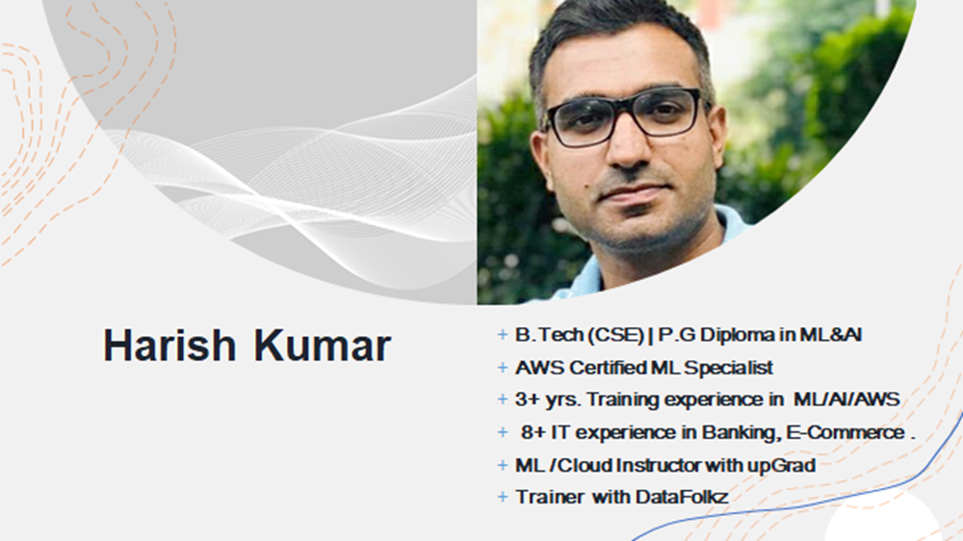

Slide 2
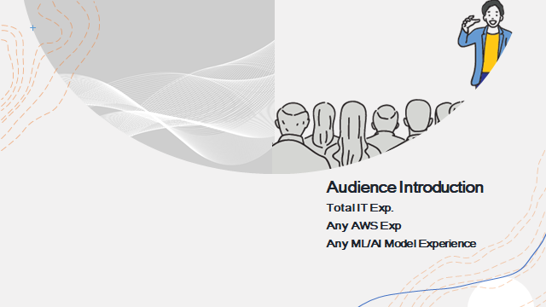

Slide 3
What is ML-OPs
★ MLOps is about building a scalable team ML Researcher, Data Engineer , Product Managers, DevOps.
Software Engineering
★ Extension of DevOps to ML as ﬁrst class citizen.
★ Infrastructure and tooling to Productionize ML
ML-Ops
Machine Learning
Developer Operations

Slide 4
The goal of MLOps is to reduce technical friction to get the model from an idea into production in the shortest possible time with as little risk as possible.

Slide 5
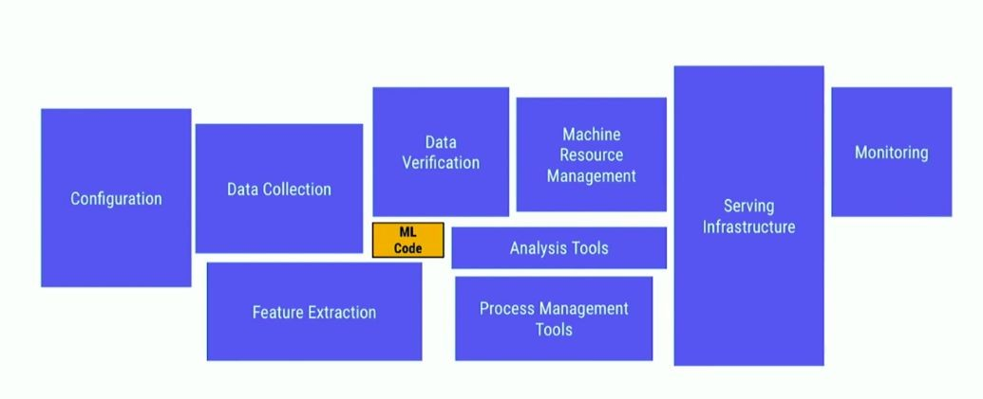
“ Machine Learning means Building a model from example inputs to make data-driven predictions vs. following strictly static program instructions. ”

Slide 6
MLOps is not a single tool or platform
MLOps is about agreeing to do ML the right way and then supporting it.
MLOps is an ML engineering culture that includes the following practices:
Continuous Integration (CI) extends the testing and validating code and components by adding testing and validating data and models.
Continuous Delivery (CD) concerns with delivery of an ML training pipeline that automatically deploys another the ML model prediction service.
Continuous Training (CT) is unique to ML systems property, which automatically retrains ML models for re-deployment.
Continuous Monitoring (CM) concerns with monitoring production data and model performance metrics, which are bound to business metrics.

Slide 7
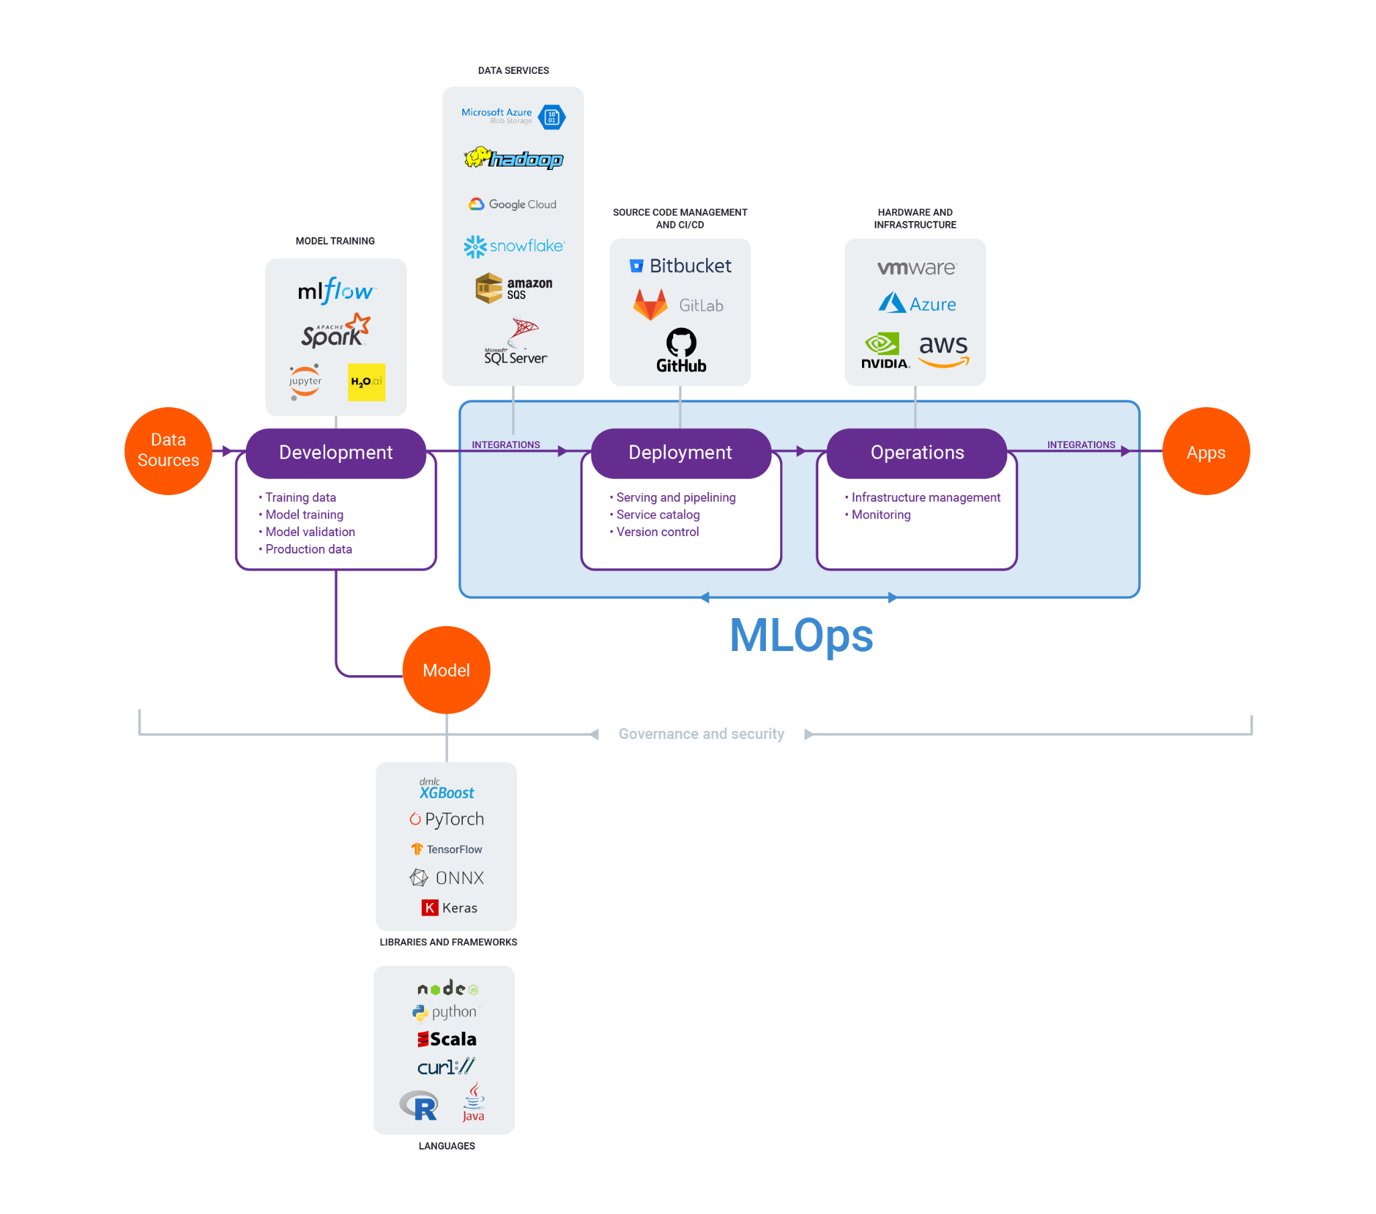
MLOPs Stack

Slide 8
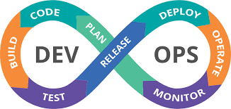
DevOps

Slide 9
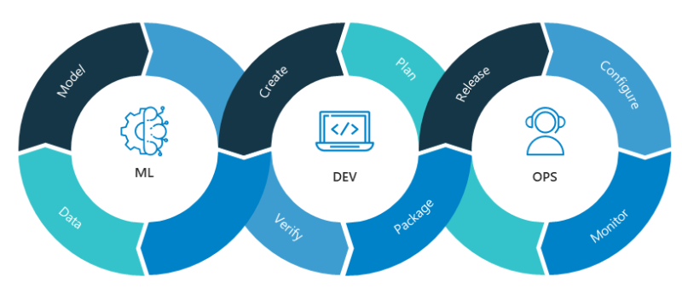
MLOps

Slide 10
DevOps
MLOps
DevOps focuses on building a generic application and uses a standard set of libraries for specific use cases.
Software developed using the DevOps technique doesn’t usually degrade and if anything new is to be added, it can be easily incorporated, new features can be added on top of the already built solution.
MLOps builds a model that feeds inferences and also has a broad scope for languages, tools, libraries, and many frameworks
in MLOps, machine learning or an AI solution developed may degrade because of the change in new test data with time.

Slide 11
DevOps
MLOps
In DevOps, code creates an application that is converted to an executable and then deployed by validating using wide series of test cases.
in DevOps only CI/CD (Continous Integration and Continous Deployment) pipeline is required.
in MLOps, code is done to build or train a machine learning model. Validation is done to check the accuracy of the model i.e how well it performs for test data. This cycle is repeated until the model gives a performance at a threshold.
in MLOps one additional thing is required and that is retraining

Slide 12
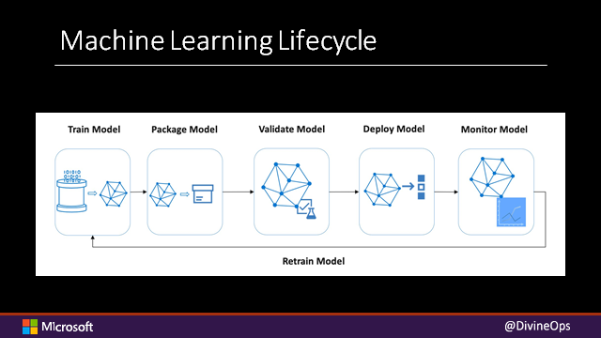

Slide 13
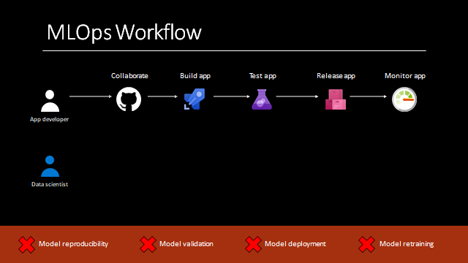

Slide 14
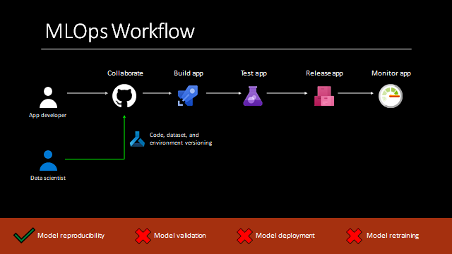

Slide 15
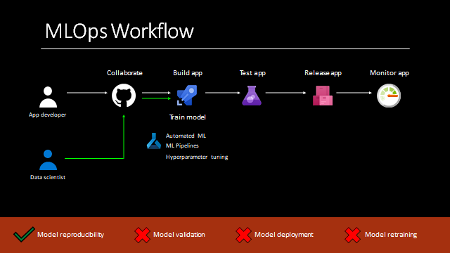

Slide 16
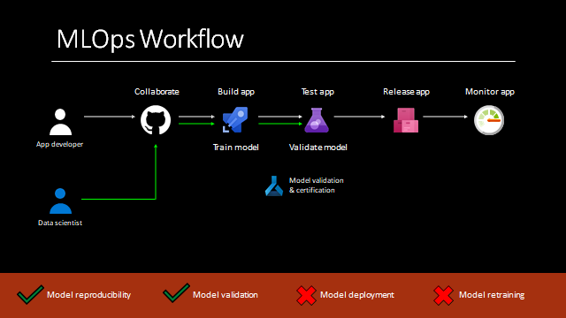

Slide 17
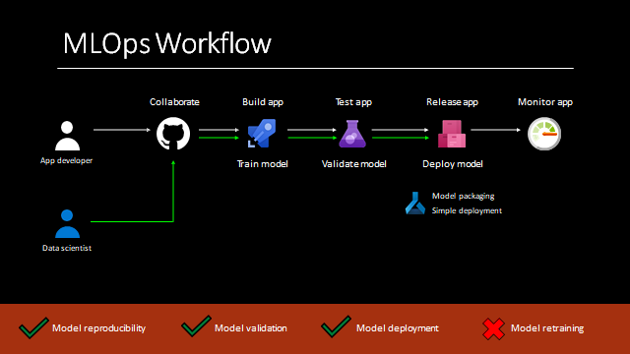

Slide 18
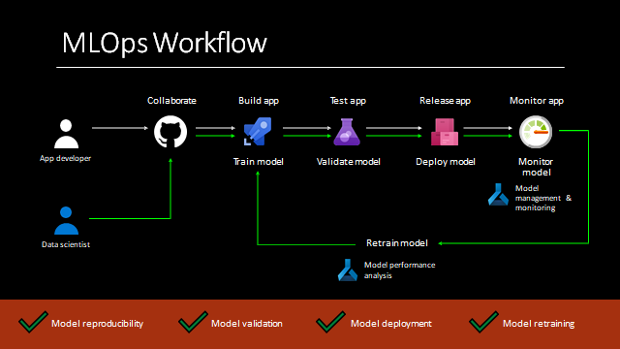

Slide 19
Benefits of MLOps
Adopting MLOps practices gives you faster time-to-market for ML projects by delivering the following benefits.
Productivity: Providing self-service environments with access to curated data sets lets data engineers and data scientists move faster and waste less time with missing or invalid data.
Repeatability: Automating all the steps in the MLDC helps you ensure a repeatable process, including how the model is trained, evaluated, versioned, and deployed.
Reliability: Incorporating CI/CD practices allows for the ability to not only deploy quickly but with increased quality and consistency.
Auditability: Versioning all inputs and outputs, from data science experiments to source data to trained model, means that we can demonstrate exactly how the model was built and where it was deployed.
Data and model quality: MLOps lets us enforce policies that guard against model bias and track changes to data statistical properties and model quality over time.

Slide 20
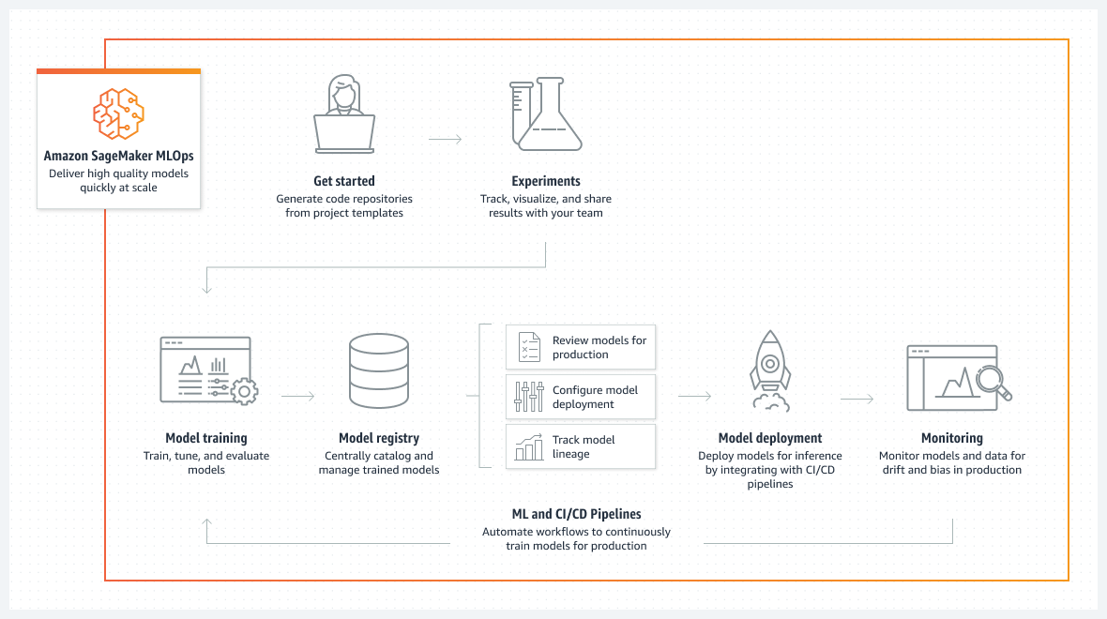
MLOPs Architecture (Using SageMaker)

Slide 21
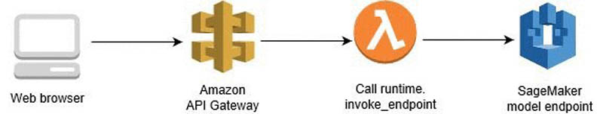
MLOPs (Using SageMaker,Lambda,API Gateway)

Slide 22
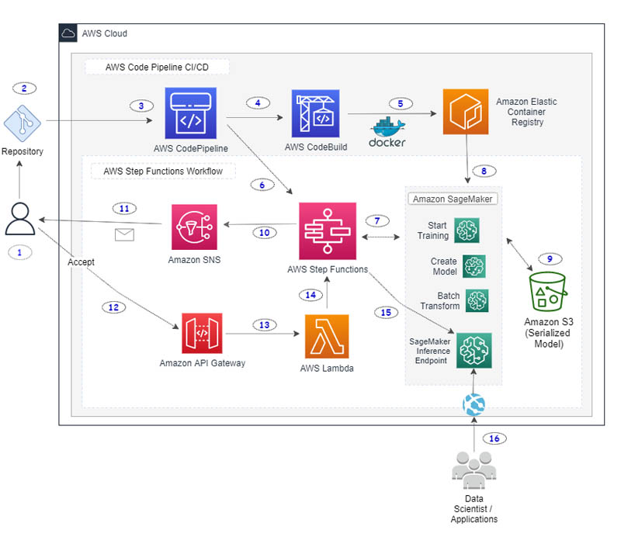
MLOps CI/CD pipeline(Using AWS Services)

Slide 23
The data scientist works on developing custom ML model code using their local notebook or a SageMaker notebook. They commit and push changes to a source code repository.
A webhook on the code repository triggers a CodePipeline build in the AWS Cloud.
CodePipeline downloads the source code and starts the build process.
CodeBuild downloads the necessary source files and starts running commands to build and tag a local Docker container image.
CodeBuild pushes the container image to Amazon ECR. The container image is tagged with a unique label derived from the repository commit hash.
CodePipeline invokes Step Functions and passes the container image URI and the unique container image tag as parameters to Step Functions.
Step Functions starts a workflow by initially calling the SageMaker training job and passing the necessary parameters.
SageMaker downloads the necessary container image and starts the training job. When the job is complete, Step Functions directs SageMaker to create a model and store the model in the S3 bucket.

Slide 24
Step Functions starts a SageMaker batch transform job on the test data provided in the S3 bucket.
When the batch transform job is complete, Step Functions sends an email to the user using Amazon Simple Notification Service (Amazon SNS). This email includes the details of the batch transform job and links to the test data prediction outcome stored in the S3 bucket. After sending the email, Step Function enters a manual wait phase.
The email sent by Amazon SNS has links to either accept or reject the test results. The recipient can manually look at the test data prediction outcomes in the S3 bucket. If they’re not satisfied with the results, they can reject the changes to cancel the Step Functions workflow.
If the recipient accepts the changes, an Amazon API Gateway endpoint invokes a Lambda function with an embedded token that references the waiting Step Functions step.
The Lambda function calls Step Functions to continue the workflow.
Step Functions resumes the workflow.
Step Functions creates a SageMaker endpoint config and a SageMaker inference endpoint.
When the workflow is successful, Step Functions sends an email with a link to the final SageMaker inference endpoint.

Slide 25
AWS Free Account Creation
https://aws.amazon.com/free

Slide 26
DVC (Data Version Control)
Data Version Control, or DVC, is a data and ML experiments management tool which is very similar to Git. It helps us to track and save data and ML models. DVC saves information about the data in special metafiles that replace the data in the repository. These can be versioned with regular Git workflows (branches, pull requests, etc). DVC uses a built-in cache to store the data, and supports synchronizing it with remote storage options like was s3, google drive, Microsoft azure, google cloud etc.

Slide 27
AWS S3
Amazon Simple Storage Service (Amazon S3) is an object storage service offering industry-leading scalability, data availability, security, and performance. Customers of all sizes and industries can store and protect any amount of data for virtually any use case, such as data lakes, cloud-native applications, and mobile apps. With cost-effective storage classes and easy-to-use management features, you can optimize costs, organize data, and configure fine-tuned access controls to meet specific business, organizational, and compliance requirements.

